Slide 1
Homework #5 Discussion
Does your formulation yield a schedule or an aggregate plan?
How would your formulation change if machines had to be recalibrated for different products (i.e., “setup cost”)?
Don’t forget
Assumptions are critical to modeling
Non-negativity constraints on decision variables (else your problem instance may be unbounded)
Proper use of notation when indexing constraints (see my notes in Canvas)
Proper use of set notation for summations within constraints

Slide 2
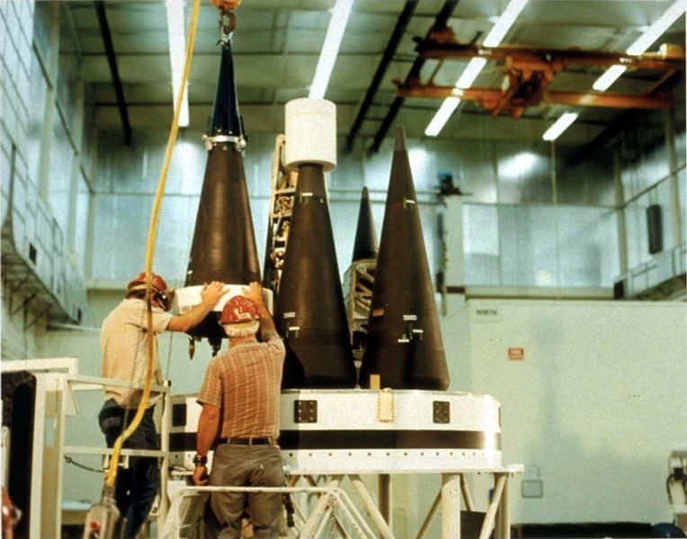
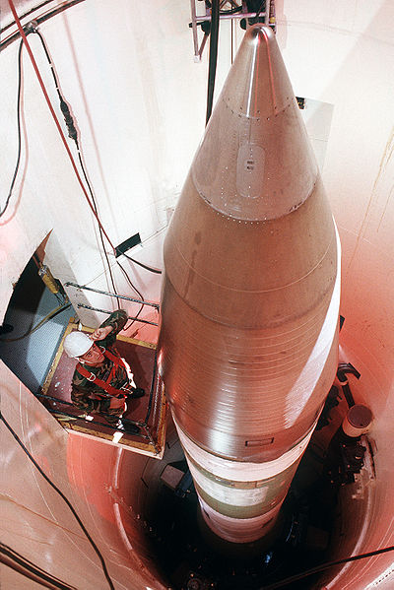
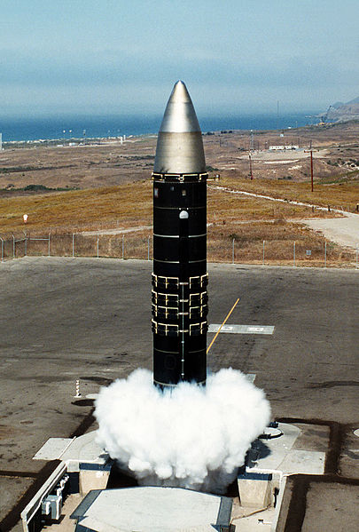
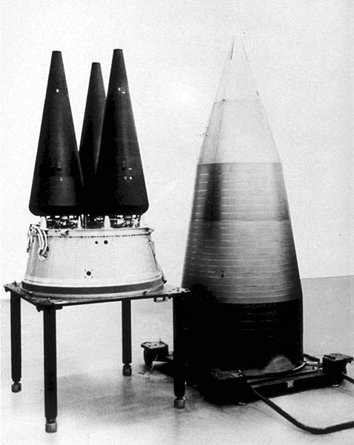

Slide 3
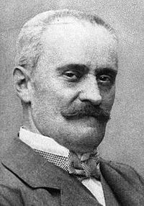
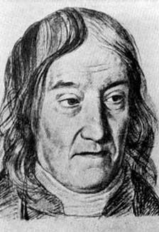
OPER 610 Lesson 08 Farkas’s Lemma
Gyla Farkas,
Not Farkas Bolyai
(a.k.a., the other Hungarian mathematician named “Farkas”)
1847 –1930
Dr Brian J. Lunday
Office: Rm 201E, Bldg 641

Slide 4
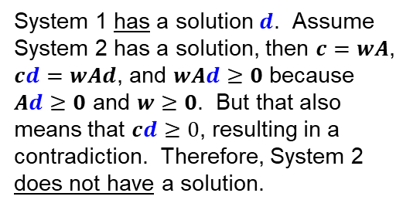
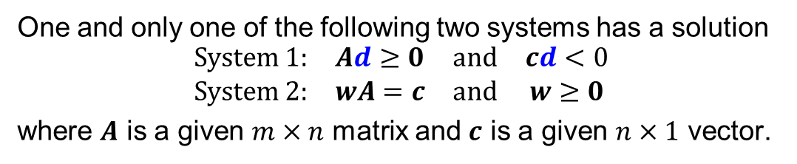
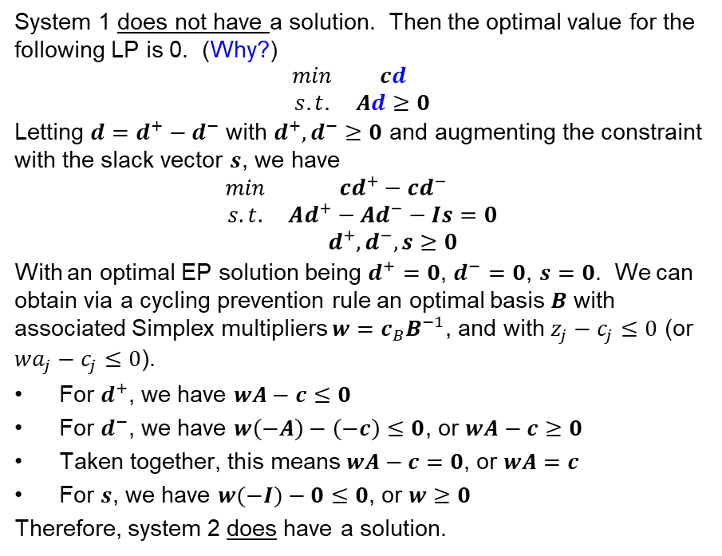
Farka’s Lemma (Theorem of the Alternative)
One and only one of the following two systems has a solution
$$\begin{matrix}System 1: & Ad≥0 & and & cd<0 \\ System 2: & wA=c & and & w≥0\end{matrix}$$
where $A$ is a given $m×n$ matrix and $c$ is a given $n×1$ vector.
System 1 has a solution $d$. Assume System 2 has a solution, then $c=wA$, $cd=wAd$, and $wAd≥0$ because $Ad≥0$ and $w≥0$. But that also means that $cd≥0$, resulting in a contradiction. Therefore, System 2 does not have a solution.
System 1 does not have a solution. Then the optimal value for the following LP is 0. (Why?)
$$\begin{matrix}min & cd \\ s.t. & Ad≥0\end{matrix}$$
Letting $d=d^{+}−d^{−}$ with $d^{+},d^{−}≥0$ and augmenting the constraint with the slack vector $s$, we have
$$\begin{matrix}min & cd^{+}−{cd}^{−} \\ s.t. & Ad^{+}−Ad^{−}−Is=0 \\ & d^{+},d^{−},s≥0\end{matrix}$$
With an optimal EP solution being $d^{+}=0$, $d^{−}=0$, $s=0$. We can obtain via a cycling prevention rule an optimal basis $B$ with associated Simplex multipliers $w=c_{B}B^{−1}$, and with $z_{j}−c_{j}≤0$ (or $wa_{j}−c_{j}≤0$).
For $d^{+}$, we have $wA−c≤0$
For $d^{−}$, we have $w\left(−A\right)−\left(−c\right)≤0$, or $wA−c≥0$
Taken together, this means $wA−c=0$, or $wA=c$
For $s$, we have $w(−I)−0≤0$, or $w≥0$
Therefore, system 2 does have a solution.
For this two-directional proof:
What is being proven? Statement, contrapositive?
How is it being proven? Direct proof, induction proof, proof by contradiction, other?

Slide 5








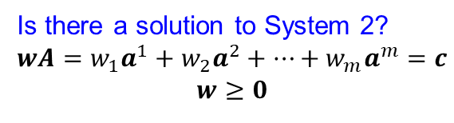


Geometry of Farka’s Lemma (n=2; two-dimensional representation)
Is there a solution to System 2?
$$\begin{matrix}wA=w_{1}a^{1}+w_{2}a^{2}+…+w_{m}a^{m}=c \\ w≥0\end{matrix}$$
$$a^{1}$$
$$a^{1}$$
$$c$$
$$a^{m}$$
$$a^{m}$$
$$a^{2}$$
$$a^{3}$$
$$a^{2}$$
$$a^{3}$$
$$c$$
YES
NO
Instance #1
Instance #2
Does $c$ lie within the cone formed by the vectors $a^{1},a^{2},…,a^{m}$, i.e., $c∈C(a^{1},a^{2},…,a^{m})$?

Slide 6

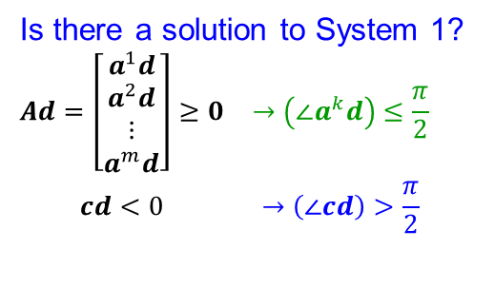







Geometry of Farka’s Lemma (n=2; two-dimensional representation)
Is there a solution to System 1?
$$\begin{matrix}Ad=\left[\begin{aligned}a^{1}d \\ a^{2}d \\ ⋮ \\ a^{m}d\end{aligned}\right]≥0 & →\left(∠a^{k}d\right)≤\frac{π}{2} \\ cd<0 & →\left(∠cd\right)>\frac{π}{2}\end{matrix}$$
Recall $ab=\left\|a\right\|\left\|b\right\|cos⁡(∠ab)$
$$a^{1}$$
$$a^{1}$$
$$c$$
$$a^{m}$$
$$a^{m}$$
$$a^{2}$$
$$a^{3}$$
$$a^{2}$$
$$a^{3}$$
$$c$$
Instance #1
Instance #2
NO
YES
Is there a feasible, improving direction $d$?

Slide 7
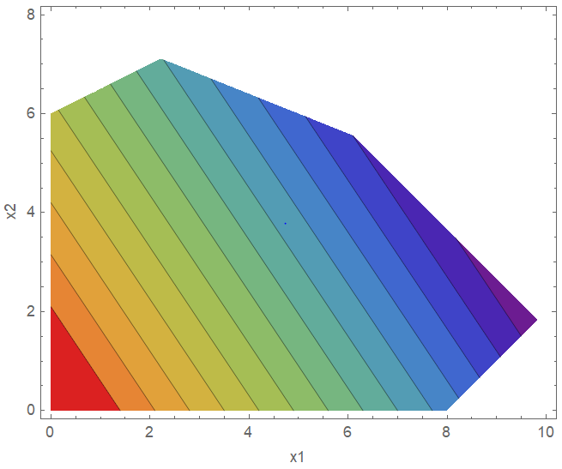
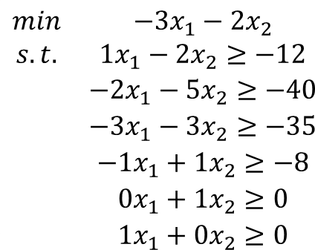
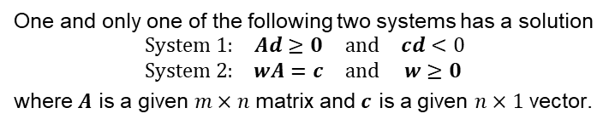
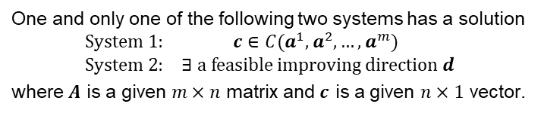
Significance of Farka’s Lemma
One and only one of the following two systems has a solution
$$\begin{matrix}System 1: & Ad≥0 & and & cd<0 \\ System 2: & wA=c & and & w≥0\end{matrix}$$
where $A$ is a given $m×n$ matrix and $c$ is a given $n×1$ vector.
One and only one of the following two systems has a solution
$$\begin{matrix}System 1: & c∈C(a^{1},a^{2},…,a^{m}) \\ System 2: & ∃ a feasible improving direction d\end{matrix}$$
where $A$ is a given $m×n$ matrix and $c$ is a given $n×1$ vector.
$$\begin{matrix}min & −3x_{1}−2x_{2} \\ s.t. & 1x_{1}−2x_{2}≥−12 \\ & −2x_{1}−5x_{2}≥−40 \\ & −3x_{1}−3x_{2}≥−35 \\ & −1x_{1}+1x_{2}≥−8 \\ & 0x_{1}+1x_{2}≥0 \\ & 1x_{1}+0x_{2}≥0\end{matrix}$$
c
1
2
3
1
2
4
5
6
3
Theorem 3.3. If an optimal solution exists, then an optimal EP exists.
→ We can restrict our examination to the EPs.
6
c
4
5

Slide 8
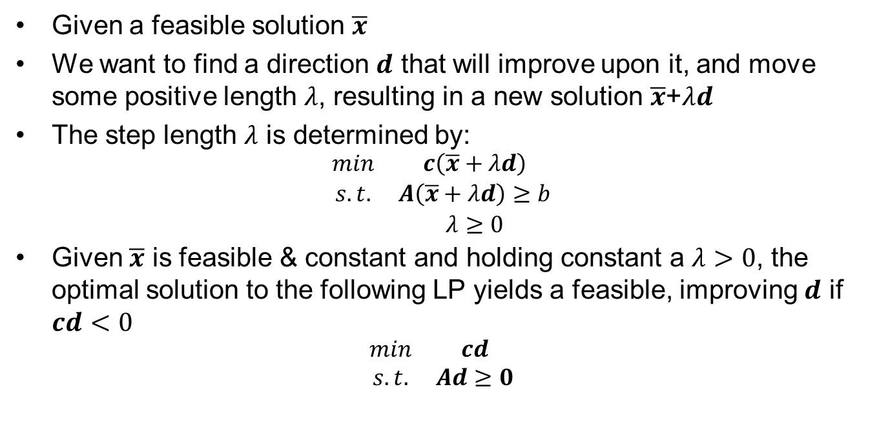
The Significance of System 1 in Farka’s Lemma
Given a feasible solution $\overline{x}$
We want to find a direction $d$ that will improve upon it, and move some positive length $λ$, resulting in a new solution $\overline{x}$+$λd$
The step length $λ$ is determined by:
$$\begin{matrix}min & c\left(\overline{x}+λd\right) \\ s.t. & A\left(\overline{x}+λd\right)≥b \\ & λ≥0\end{matrix}$$
Given $\overline{x}$ is feasible & constant and holding constant a $λ>0$, the optimal solution to the following LP yields a feasible, improving $d$ if $cd<0$
$$\begin{matrix}min & cd \\ s.t. & Ad≥0\end{matrix}$$

Slide 9
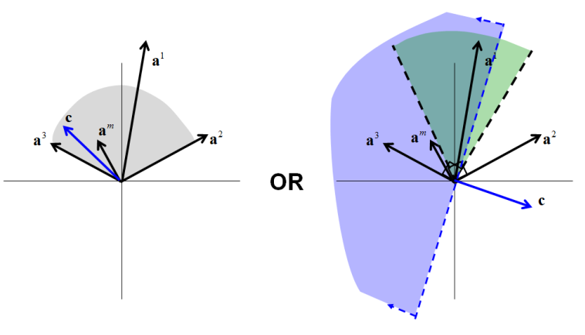
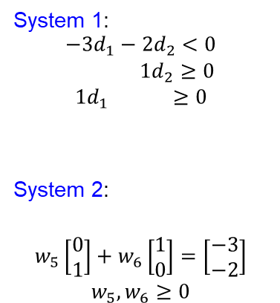
Examination of Farka’s Lemma (Bottom Left EP)
One and only one of the following two systems has a solution
$$\begin{matrix}System 1: & Ad≥0 & and & cd<0 \\ System 2: & wA=c & and & w≥0\end{matrix}$$
where $A$ is a given $m×n$ matrix and $c$ is a given $n×1$ vector.
One and only one of the following two systems has a solution
$$\begin{matrix}System 1: & c∈C(a^{1},a^{2},…,a^{m}) \\ System 2: & ∃ a feasible improving direction d\end{matrix}$$
where $A$ is a given $m×n$ matrix and $c$ is a given $n×1$ vector.
$$\begin{matrix}min & −3x_{1}−2x_{2} \\ s.t. & 1x_{1}−2x_{2}≥−12 \\ & −2x_{1}−5x_{2}≥−40 \\ & −3x_{1}−3x_{2}≥−35 \\ & −1x_{1}+1x_{2}≥−8 \\ & 0x_{1}+1x_{2}≥0 \\ & 1x_{1}+0x_{2}≥0\end{matrix}$$
c
System 1:
$$\begin{matrix}−3d_{1}−2d_{2}<0 \\ 1d_{2}≥0 \\ 1d_{1} ≥0\end{matrix}$$
System 2:
$$\begin{matrix}w_{5}\left[\begin{aligned}0 \\ 1\end{aligned}\right]+w_{6}\left[\begin{aligned}1 \\ 0\end{aligned}\right]=\left[\begin{aligned}−3 \\ −2\end{aligned}\right] \\ w_{5},w_{6}≥0\end{matrix}$$
c
5
6
6
5
5
6
5
6
c
System 2 has a solution
System 1 has a solution

Slide 10
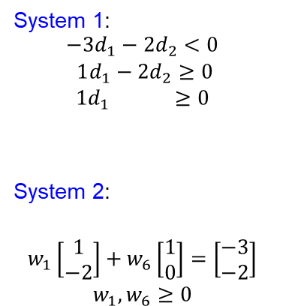
Examination of Farka’s Lemma (Upper Left EP)
One and only one of the following two systems has a solution
$$\begin{matrix}System 1: & Ad≥0 & and & cd<0 \\ System 2: & wA=c & and & w≥0\end{matrix}$$
where $A$ is a given $m×n$ matrix and $c$ is a given $n×1$ vector.
One and only one of the following two systems has a solution
$$\begin{matrix}System 1: & c∈C(a^{1},a^{2},…,a^{m}) \\ System 2: & ∃ a feasible improving direction d\end{matrix}$$
where $A$ is a given $m×n$ matrix and $c$ is a given $n×1$ vector.
$$\begin{matrix}min & −3x_{1}−2x_{2} \\ s.t. & 1x_{1}−2x_{2}≥−12 \\ & −2x_{1}−5x_{2}≥−40 \\ & −3x_{1}−3x_{2}≥−35 \\ & −1x_{1}+1x_{2}≥−8 \\ & 0x_{1}+1x_{2}≥0 \\ & 1x_{1}+0x_{2}≥0\end{matrix}$$
c
System 1:
$$\begin{matrix}−3d_{1}−2d_{2}<0 \\ 1d_{1}−2d_{2}≥0 \\ 1d_{1} ≥0\end{matrix}$$
System 2:
$$\begin{matrix}w_{1}\left[\begin{aligned}1 \\ −2\end{aligned}\right]+w_{6}\left[\begin{aligned}1 \\ 0\end{aligned}\right]=\left[\begin{aligned}−3 \\ −2\end{aligned}\right] \\ w_{1},w_{6}≥0\end{matrix}$$
1
c
1
6
1
1
6
c
6
6
System 2 has a solution
System 1 has a solution

Slide 11
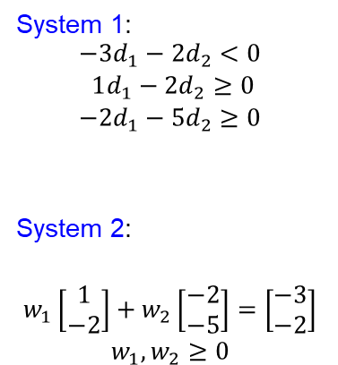
Examination of Farka’s Lemma (Topmost EP)
One and only one of the following two systems has a solution
$$\begin{matrix}System 1: & Ad≥0 & and & cd<0 \\ System 2: & wA=c & and & w≥0\end{matrix}$$
where $A$ is a given $m×n$ matrix and $c$ is a given $n×1$ vector.
One and only one of the following two systems has a solution
$$\begin{matrix}System 1: & c∈C(a^{1},a^{2},…,a^{m}) \\ System 2: & ∃ a feasible improving direction d\end{matrix}$$
where $A$ is a given $m×n$ matrix and $c$ is a given $n×1$ vector.
$$\begin{matrix}min & −3x_{1}−2x_{2} \\ s.t. & 1x_{1}−2x_{2}≥−12 \\ & −2x_{1}−5x_{2}≥−40 \\ & −3x_{1}−3x_{2}≥−35 \\ & −1x_{1}+1x_{2}≥−8 \\ & 0x_{1}+1x_{2}≥0 \\ & 1x_{1}+0x_{2}≥0\end{matrix}$$
c
System 1:
$$\begin{matrix}−3d_{1}−2d_{2}<0 \\ 1d_{1}−2d_{2}≥0 \\ −2d_{1}−5d_{2}≥0\end{matrix}$$
System 2:
$$\begin{matrix}w_{1}\left[\begin{aligned}1 \\ −2\end{aligned}\right]+w_{2}\left[\begin{aligned}−2 \\ −5\end{aligned}\right]=\left[\begin{aligned}−3 \\ −2\end{aligned}\right] \\ w_{1},w_{2}≥0\end{matrix}$$
1
c
2
1
2
1
2
1
2
c
System 2 has a solution
System 1 has a solution

Slide 12
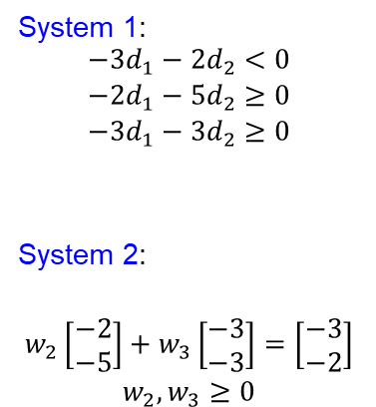
Examination of Farka’s Lemma (Upper Right EP)
One and only one of the following two systems has a solution
$$\begin{matrix}System 1: & Ad≥0 & and & cd<0 \\ System 2: & wA=c & and & w≥0\end{matrix}$$
where $A$ is a given $m×n$ matrix and $c$ is a given $n×1$ vector.
One and only one of the following two systems has a solution
$$\begin{matrix}System 1: & c∈C(a^{1},a^{2},…,a^{m}) \\ System 2: & ∃ a feasible improving direction d\end{matrix}$$
where $A$ is a given $m×n$ matrix and $c$ is a given $n×1$ vector.
$$\begin{matrix}min & −3x_{1}−2x_{2} \\ s.t. & 1x_{1}−2x_{2}≥−12 \\ & −2x_{1}−5x_{2}≥−40 \\ & −3x_{1}−3x_{2}≥−35 \\ & −1x_{1}+1x_{2}≥−8 \\ & 0x_{1}+1x_{2}≥0 \\ & 1x_{1}+0x_{2}≥0\end{matrix}$$
c
System 1:
$$\begin{matrix}−3d_{1}−2d_{2}<0 \\ −2d_{1}−5d_{2}≥0 \\ −3d_{1}−3d_{2}≥0\end{matrix}$$
System 2:
$$\begin{matrix}w_{2}\left[\begin{aligned}−2 \\ −5\end{aligned}\right]+w_{3}\left[\begin{aligned}−3 \\ −3\end{aligned}\right]=\left[\begin{aligned}−3 \\ −2\end{aligned}\right] \\ w_{2},w_{3}≥0\end{matrix}$$
c
2
2
3
3
2
2
3
c
3
System 2 has a solution
System 1 has a solution

Slide 13
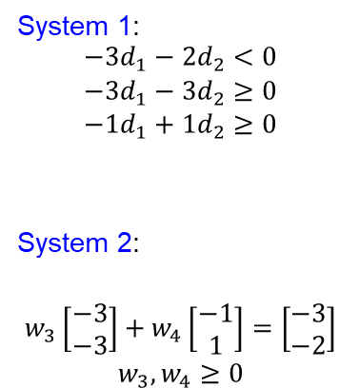
Examination of Farka’s Lemma (Rightmost EP)
One and only one of the following two systems has a solution
$$\begin{matrix}System 1: & Ad≥0 & and & cd<0 \\ System 2: & wA=c & and & w≥0\end{matrix}$$
where $A$ is a given $m×n$ matrix and $c$ is a given $n×1$ vector.
One and only one of the following two systems has a solution
$$\begin{matrix}System 1: & c∈C(a^{1},a^{2},…,a^{m}) \\ System 2: & ∃ a feasible improving direction d\end{matrix}$$
where $A$ is a given $m×n$ matrix and $c$ is a given $n×1$ vector.
$$\begin{matrix}min & −3x_{1}−2x_{2} \\ s.t. & 1x_{1}−2x_{2}≥−12 \\ & −2x_{1}−5x_{2}≥−40 \\ & −3x_{1}−3x_{2}≥−35 \\ & −1x_{1}+1x_{2}≥−8 \\ & 0x_{1}+1x_{2}≥0 \\ & 1x_{1}+0x_{2}≥0\end{matrix}$$
c
System 1:
$$\begin{matrix}−3d_{1}−2d_{2}<0 \\ −3d_{1}−3d_{2}≥0 \\ −1d_{1}+1d_{2}≥0\end{matrix}$$
System 2:
$$\begin{matrix}w_{3}\left[\begin{aligned}−3 \\ −3\end{aligned}\right]+w_{4}\left[\begin{aligned}−1 \\ 1\end{aligned}\right]=\left[\begin{aligned}−3 \\ −2\end{aligned}\right] \\ w_{3},w_{4}≥0\end{matrix}$$
c
3
3
4
3
4
3
4
c
4
System 2 has a solution
System 1 has a solution

Slide 14
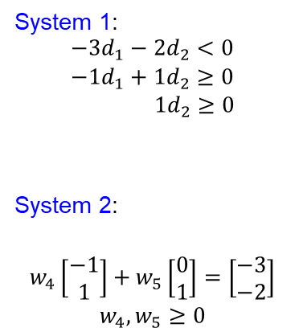
Examination of Farka’s Lemma (Bottom Right EP)
One and only one of the following two systems has a solution
$$\begin{matrix}System 1: & Ad≥0 & and & cd<0 \\ System 2: & wA=c & and & w≥0\end{matrix}$$
where $A$ is a given $m×n$ matrix and $c$ is a given $n×1$ vector.
One and only one of the following two systems has a solution
$$\begin{matrix}System 1: & c∈C(a^{1},a^{2},…,a^{m}) \\ System 2: & ∃ a feasible improving direction d\end{matrix}$$
where $A$ is a given $m×n$ matrix and $c$ is a given $n×1$ vector.
$$\begin{matrix}min & −3x_{1}−2x_{2} \\ s.t. & 1x_{1}−2x_{2}≥−12 \\ & −2x_{1}−5x_{2}≥−40 \\ & −3x_{1}−3x_{2}≥−35 \\ & −1x_{1}+1x_{2}≥−8 \\ & 0x_{1}+1x_{2}≥0 \\ & 1x_{1}+0x_{2}≥0\end{matrix}$$
c
System 1:
$$\begin{matrix}−3d_{1}−2d_{2}<0 \\ −1d_{1}+1d_{2}≥0 \\ 1d_{2}≥0\end{matrix}$$
System 2:
$$\begin{matrix}w_{4}\left[\begin{aligned}−1 \\ 1\end{aligned}\right]+w_{5}\left[\begin{aligned}0 \\ 1\end{aligned}\right]=\left[\begin{aligned}−3 \\ −2\end{aligned}\right] \\ w_{4},w_{5}≥0\end{matrix}$$
c
4
5
4
4
5
5
4
5
c
System 2 has a solution
System 1 has a solution

Slide 15
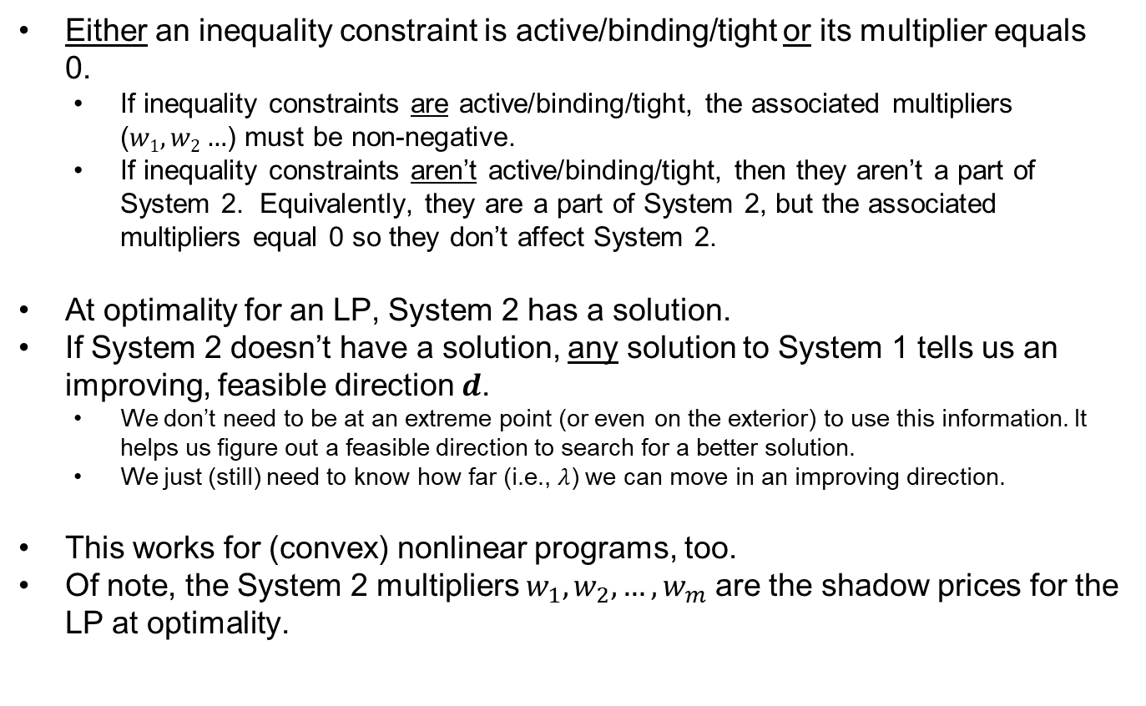
Farka’s Lemma in the Context of Extreme Points and LPs
Either an inequality constraint is active/binding/tight or its multiplier equals 0.
If inequality constraints are active/binding/tight, the associated multipliers ($w1, w2…$) must be non-negative.
If inequality constraints aren’t active/binding/tight, then they aren’t a part of System 2. Equivalently, they are a part of System 2, but the associated multipliers equal 0 so they don’t affect System 2.
At optimality for an LP, System 2 has a solution.
If System 2 doesn’t have a solution, any solution to System 1 tells us an improving, feasible direction $d$.
We don’t need to be at an extreme point (or even on the exterior) to use this information. It helps us figure out a feasible direction to search for a better solution.
We just (still) need to know how far (i.e., $λ$) we can move in an improving direction.
This works for (convex) nonlinear programs, too.
Of note, the System 2 multipliers $w_{1},w_{2},…,w_{m}$ are the shadow prices for the LP at optimality.

Slide 16


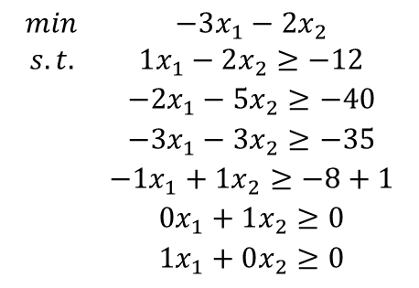


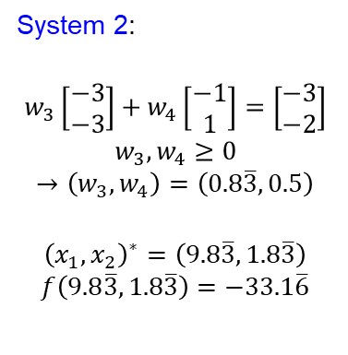
System 2 Multipliers are the Shadow Prices for the LP
$$\begin{matrix}min & −3x_{1}−2x_{2} \\ s.t. & 1x_{1}−2x_{2}≥−12 \\ & −2x_{1}−5x_{2}≥−40 \\ & −3x_{1}−3x_{2}≥−35 \\ & −1x_{1}+1x_{2}≥−8 \\ & 0x_{1}+1x_{2}≥0 \\ & 1x_{1}+0x_{2}≥0\end{matrix}$$
c
System 2:
$$\begin{matrix}w_{3}\left[\begin{aligned}−3 \\ −3\end{aligned}\right]+w_{4}\left[\begin{aligned}−1 \\ 1\end{aligned}\right]=\left[\begin{aligned}−3 \\ −2\end{aligned}\right] \\ w_{3},w_{4}≥0\end{matrix}$$
$$→\left(w_{3},w_{4}\right)=\left(0.8\overline{3},0.5\right)$$
$${\left(x_{1},x_{2}\right)}^{∗}=\left(9.8\overline{3},1.8\overline{3}\right)$$
$$f\left(9.8\overline{3},1.8\overline{3}\right)=−33.1\overline{6}$$
3
4
c
3
3
4
4
$$\begin{matrix}min & −3x_{1}−2x_{2} \\ s.t. & 1x_{1}−2x_{2}≥−12 \\ & −2x_{1}−5x_{2}≥−40 \\ & −3x_{1}−3x_{2}≥−35+1 \\ & −1x_{1}+1x_{2}≥−8 \\ & 0x_{1}+1x_{2}≥0 \\ & 1x_{1}+0x_{2}≥0\end{matrix}$$
$$\begin{matrix}min & −3x_{1}−2x_{2} \\ s.t. & 1x_{1}−2x_{2}≥−12 \\ & −2x_{1}−5x_{2}≥−40 \\ & −3x_{1}−3x_{2}≥−35 \\ & −1x_{1}+1x_{2}≥−8+1 \\ & 0x_{1}+1x_{2}≥0 \\ & 1x_{1}+0x_{2}≥0\end{matrix}$$
$${\left(x_{1},x_{2}\right)}^{∗}=\left(9.6\overline{6},1.6\overline{6}\right)$$
$$f\left(9.6\overline{6},1.6\overline{6}\right)=−32.3\overline{3}$$
$${\left(x_{1},x_{2}\right)}^{∗}=\left(9.3\overline{3},2.3\overline{3}\right)$$
$$f\left(9.3\overline{3},2.3\overline{3}\right)=−32.6\overline{6}$$

Slide 17
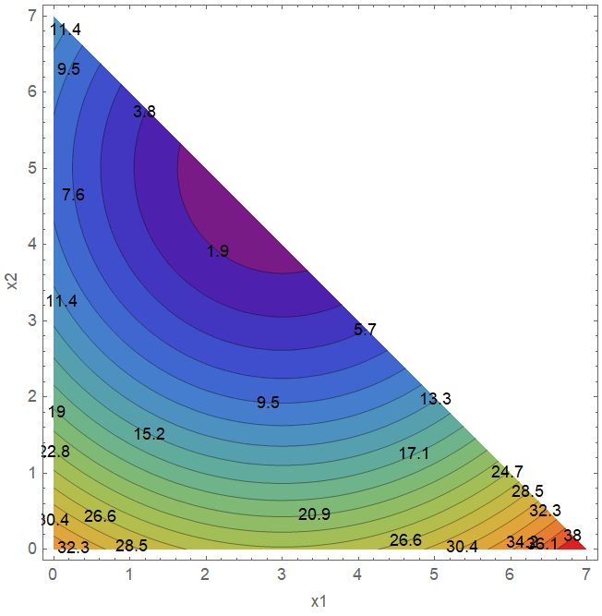
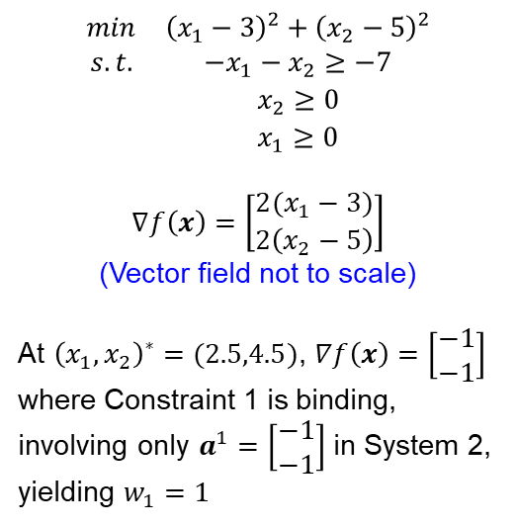
Farka’s Lemma with Convex NLPs
Convex program – convex objective & a convex feasible region
Note: Optimality doesn’t always occur at an EP with NLPs
$$\begin{matrix}min & {\left(x_{1}−3\right)}^{2}+{\left(x_{2}−5\right)}^{2} \\ s.t. & −x_{1}−x_{2}≥−7 \\ & x_{2}≥0 \\ & x_{1}≥0\end{matrix}$$
$$∇f\left(x\right)=\left[\begin{aligned}2(x_{1}−3) \\ 2\left(x_{2}−5\right)\end{aligned}\right]$$
(Vector field not to scale)
At ${\left(x_{1},x_{2}\right)}^{∗}=(2.5,4.5)$, $∇f\left(x\right)=\left[\begin{aligned}−1 \\ −1\end{aligned}\right]$
where Constraint 1 is binding, involving only $a^{1}=\left[\begin{aligned}−1 \\ −1\end{aligned}\right]$ in System 2, yielding $w_{1}=1$
c
1
2
3
c
1
3
2

Slide 18
Questions & Discussion

Slide 19
For next class
Section 5.4 – General Optimality (KKT) Conditions
Supplemental reading on Canvas
Cottle, R. W. (2012). William Karush and the KKT theorem. Doc. Math., Extra volume: Optimization stories, 255-269.
Homework #7: Problem 1.13 (Phase 2)
Include your manual formulation from Phase 1, updated and/or corrected as appropriate
Model the compact formulation in Pyomo to leverage the indices on decision variables and constraints to write a shorter (denser) formulation

